Slide 1
Statistics and Chart Presentation Bryan and Daren

Slide 2
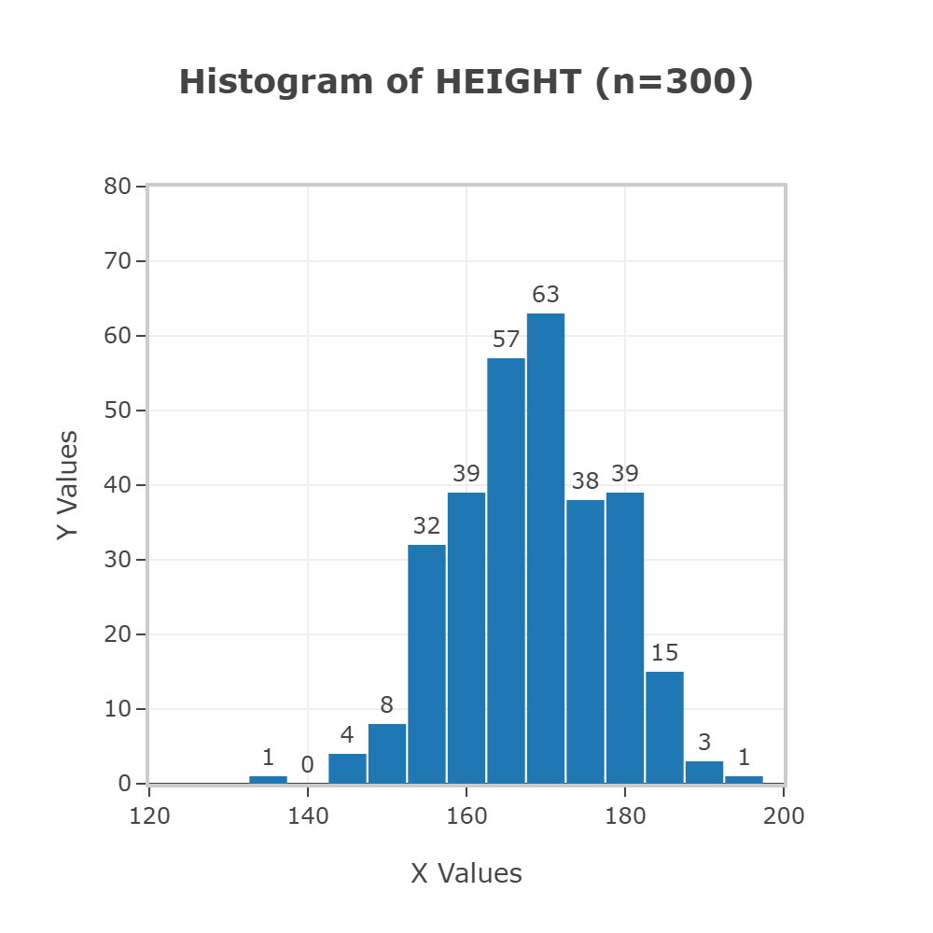
Elementary Statistics 14th edition “body data” Normality assessment for height
Statdisk.com
Skewed left
Height in inches
The data does not provide evidence against normality at both the 0.05 and 0.01 significance levels.
There is one potential outlier below the first quartile, but there are no potential outliers above the third quartile.

Slide 3
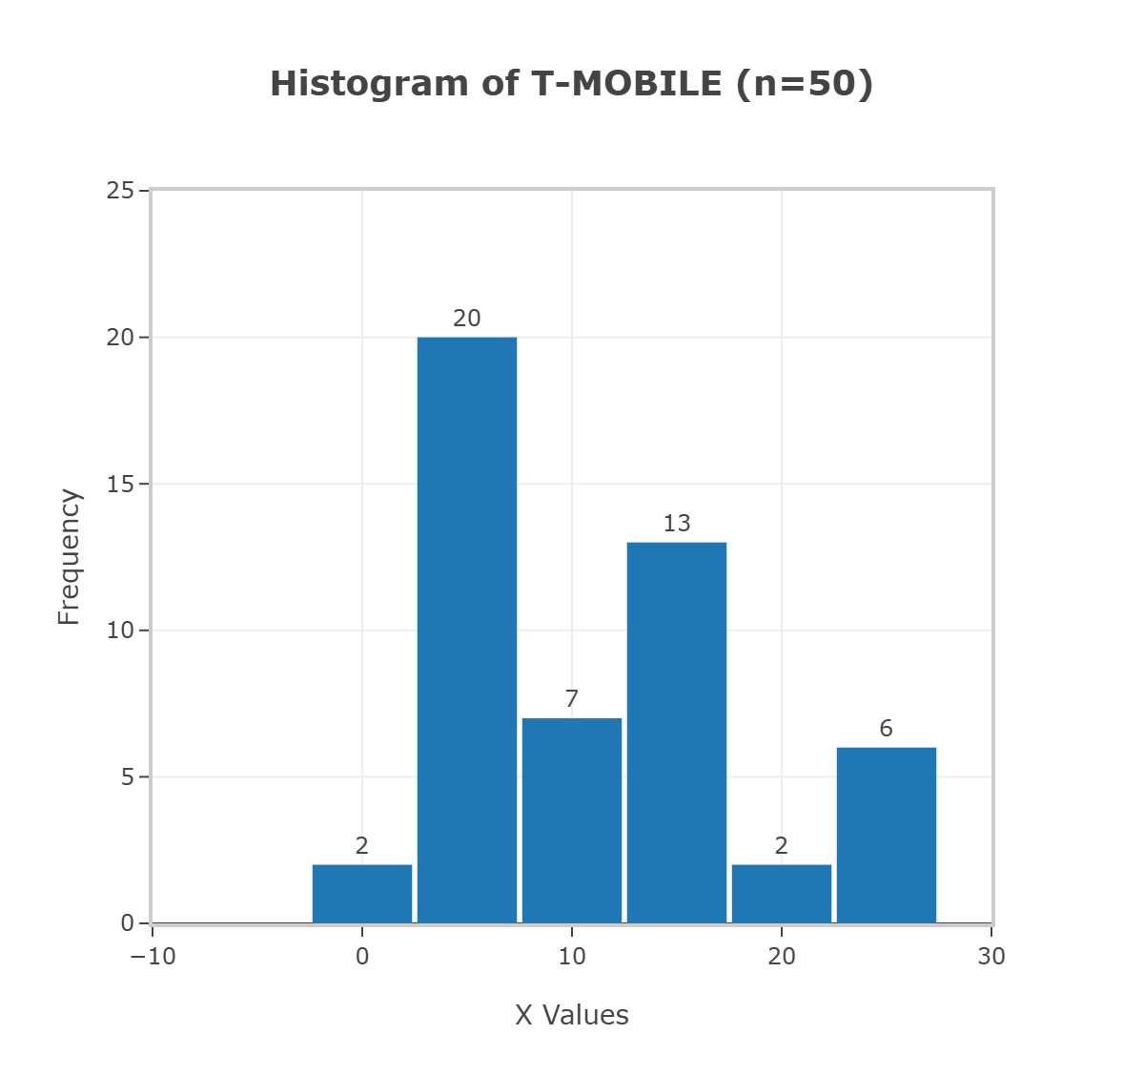
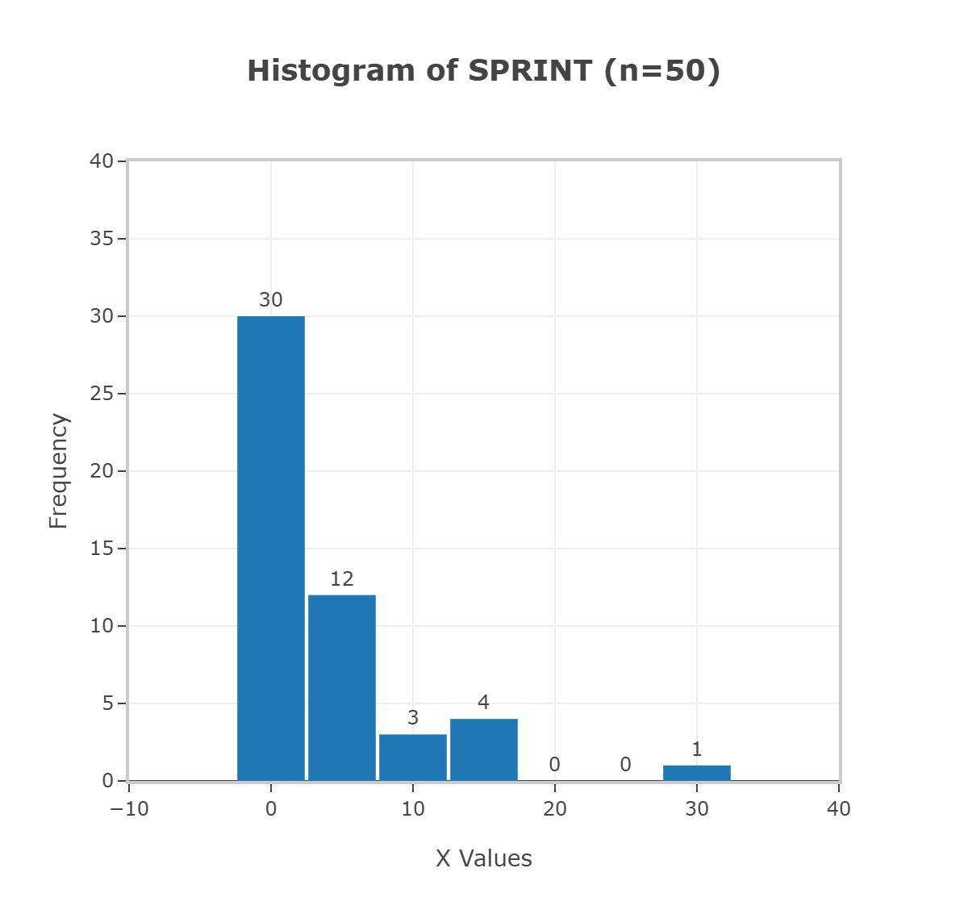
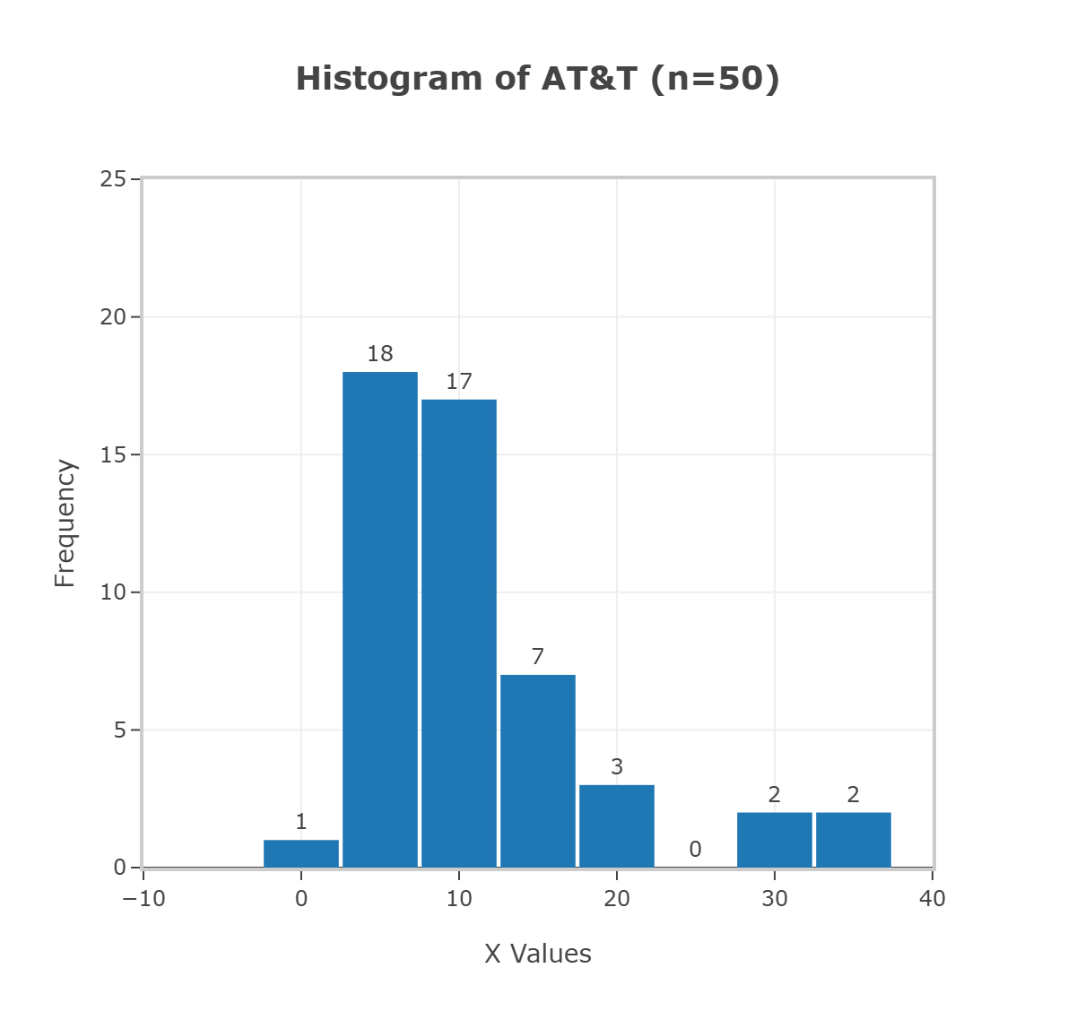
Airport data speed (statdisk.com)
Y=per airport
Sprint skewed right
AT&T skewed right
X values =speeds

Slide 4
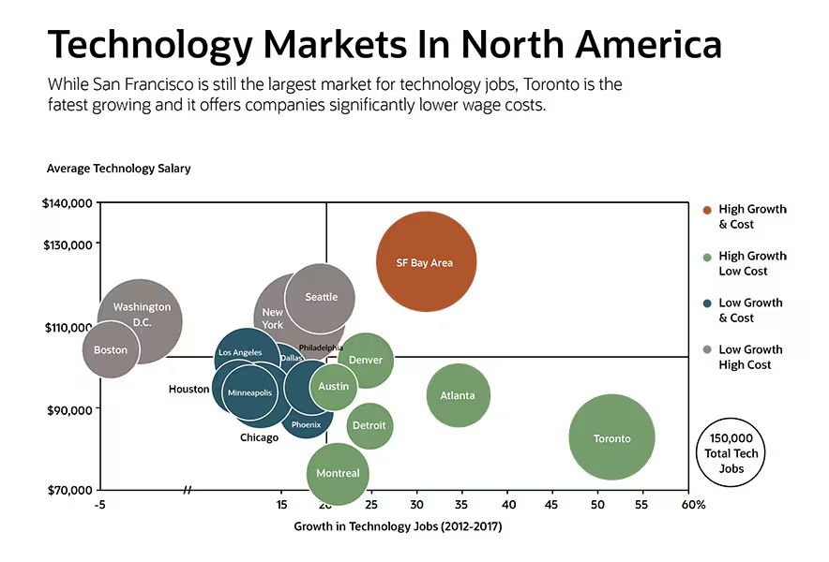
Technology Markets in North America
mekkographics.com
SF Bay Area (highest paid average salary)
Montreal (lowest paid salary)
Size of the bubble indicates market size.
Color and position suggest growth rate and cost factors

